Slide 1

IBM Carbon TreeView
Example 02

Slide 2
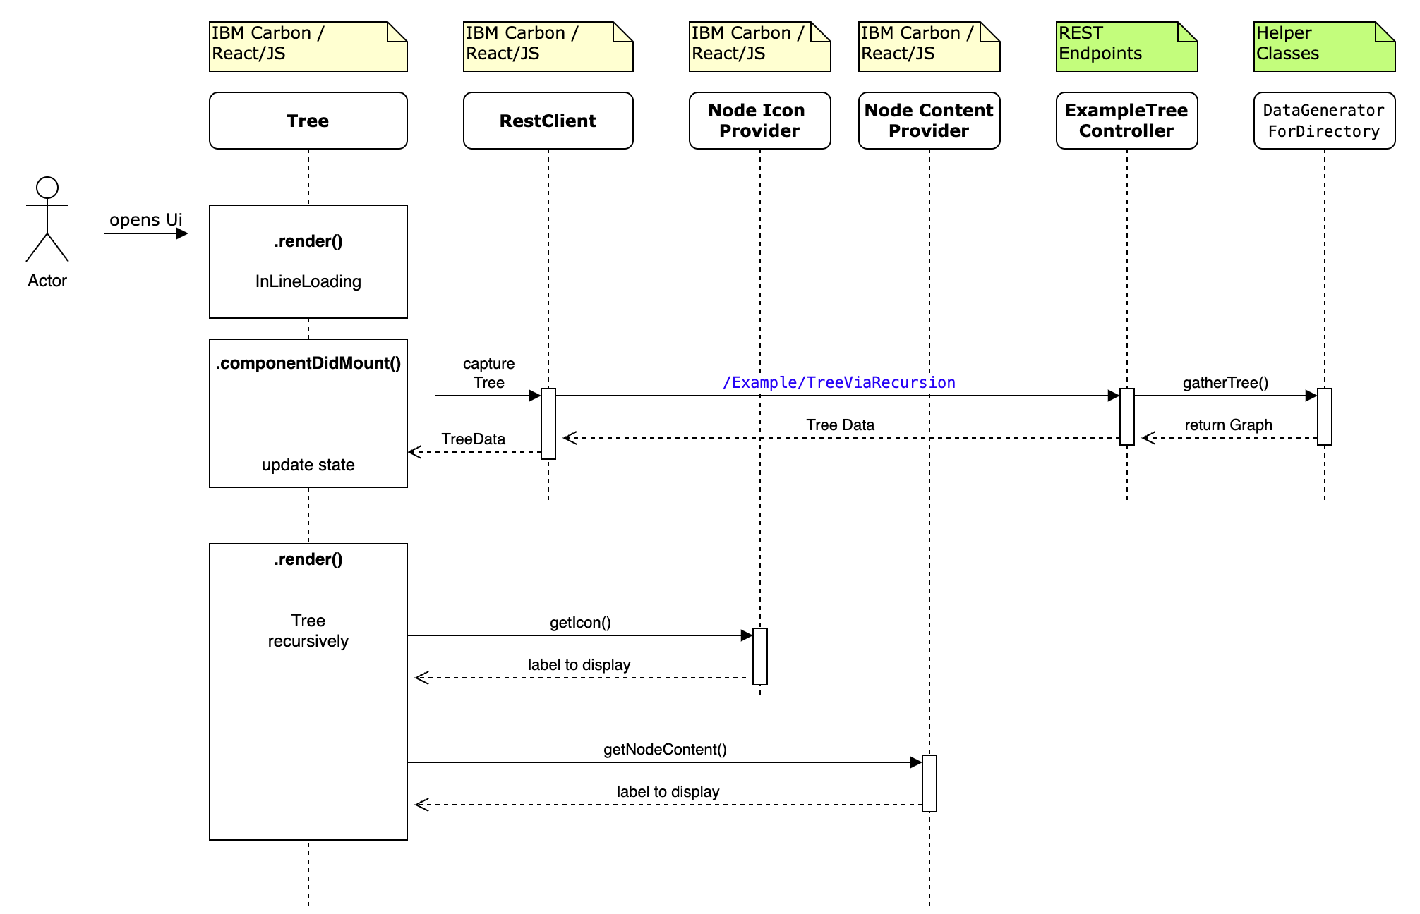
Sequence Diagram
2
1

Slide 3
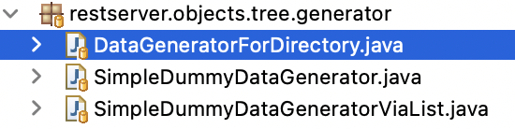
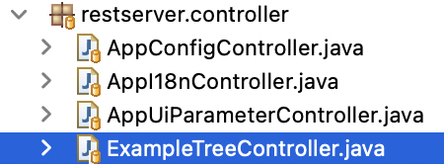
Server-sided Sources
1
2
Notes:
Here: Show one of Example Endpoints in Swagger

Slide 4
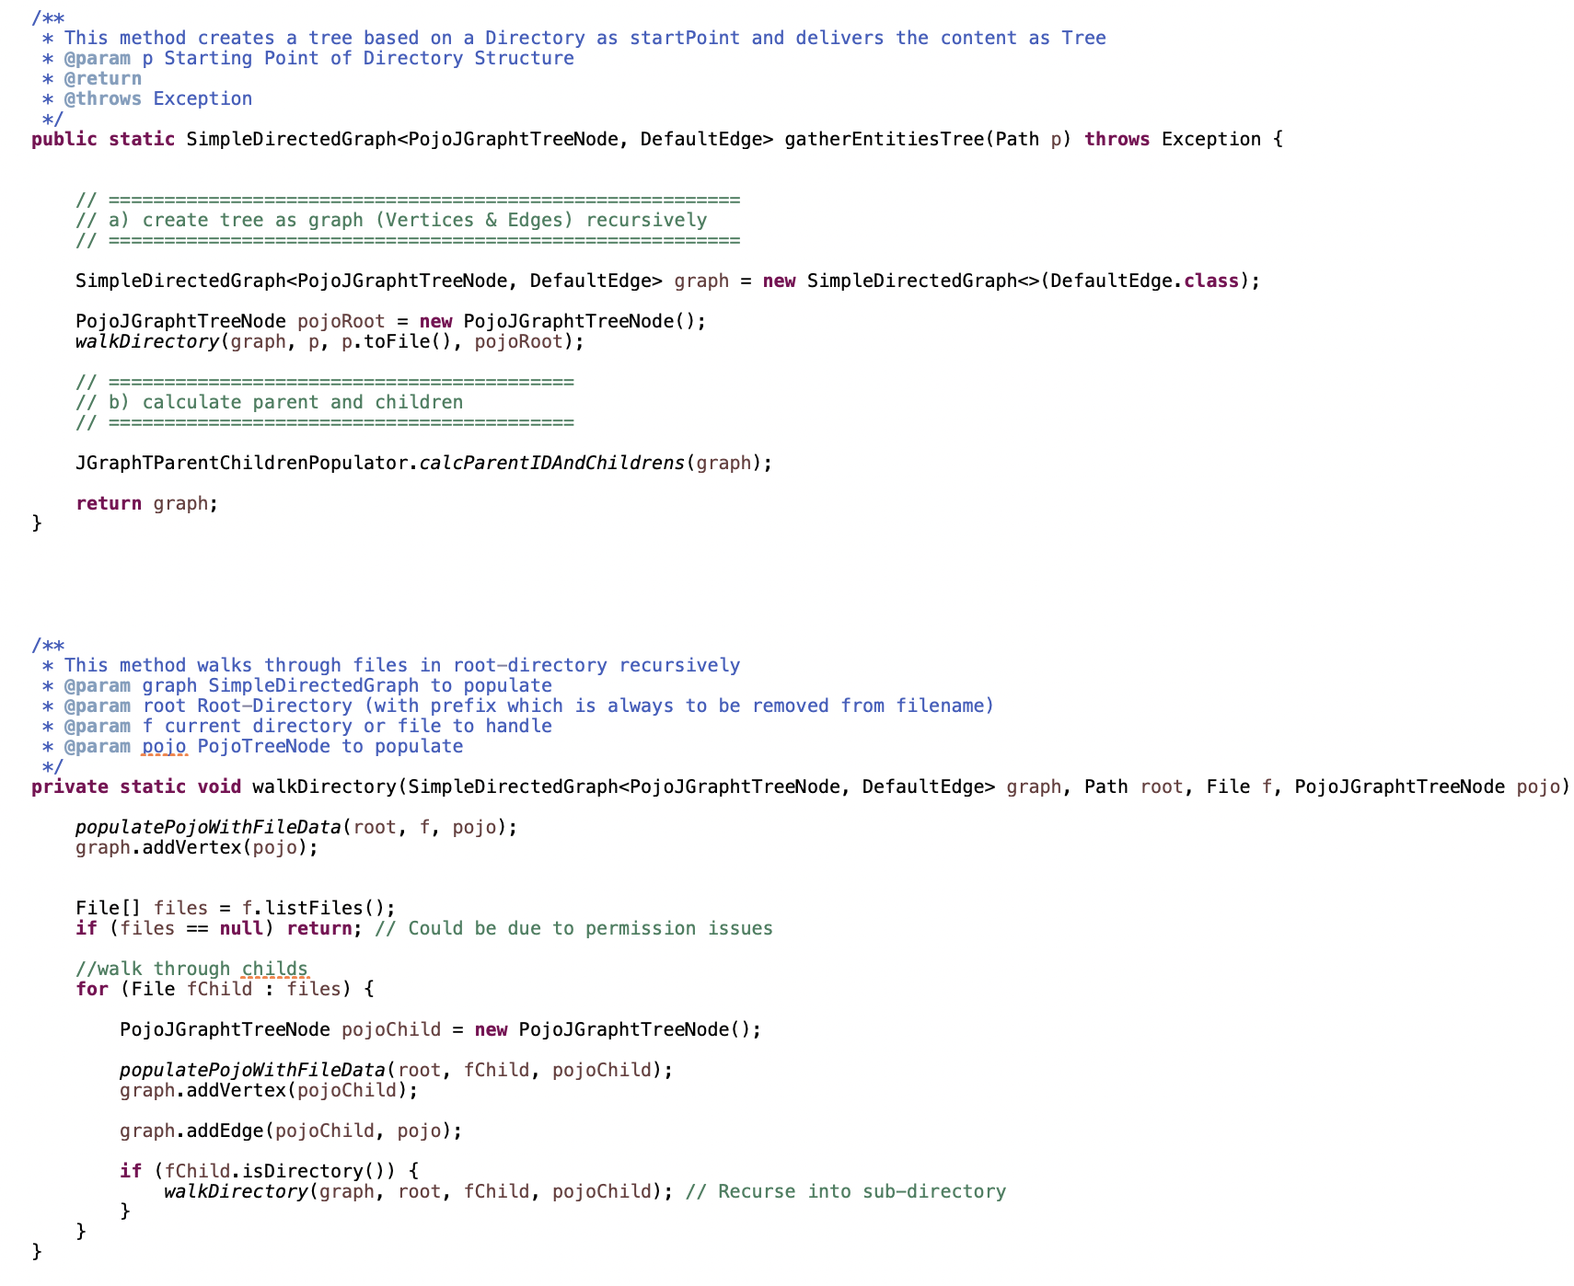
1
Start with RootPath
Recursion

Slide 5
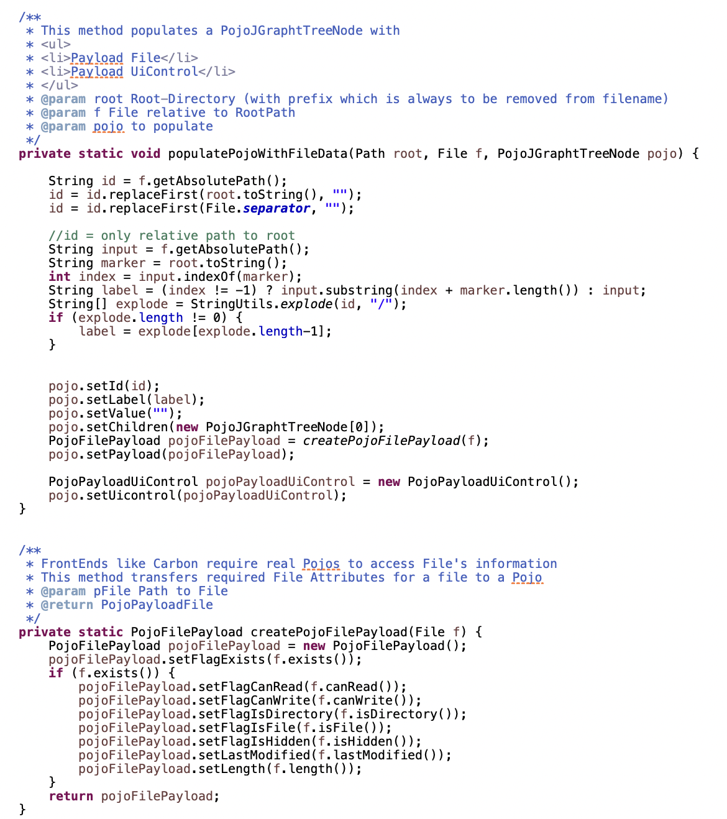
1
Populate Node
Create
Payload

Slide 6
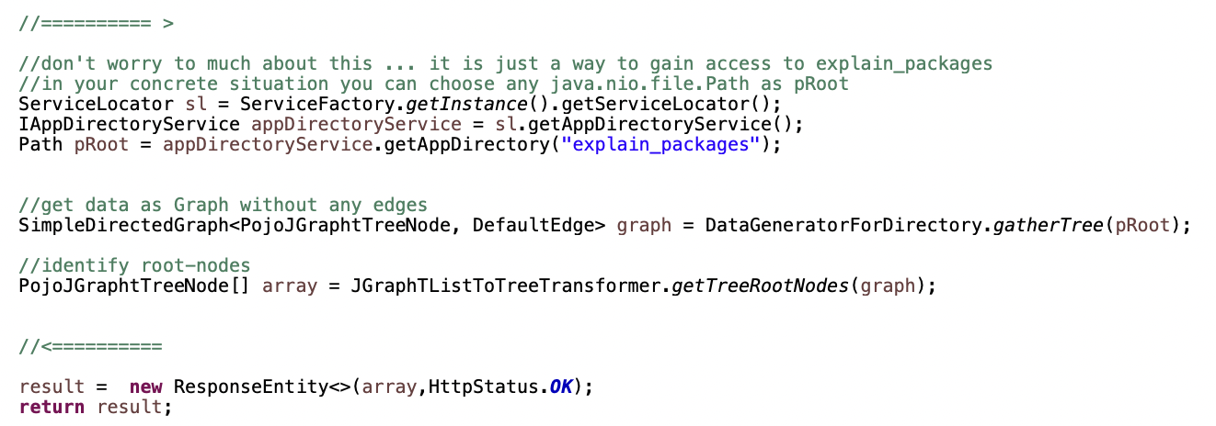
2
Notes:
root-nodes … there can be more than one
Array.sort … to present a sorted output

Slide 7
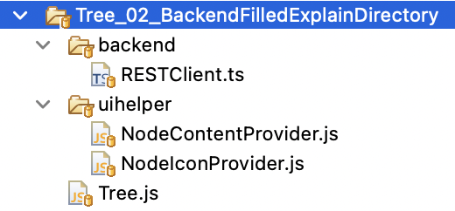

Client-sided Sources
Notes:
Let’s have a look at these sources

Slide 8
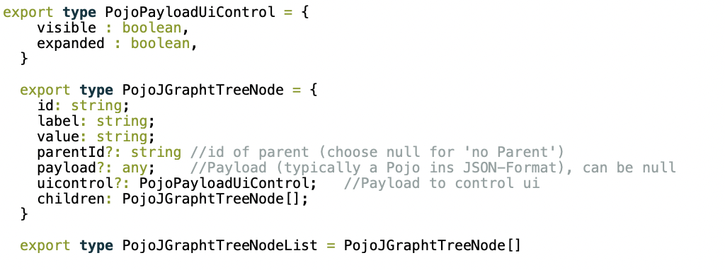
PojoJGraphtTreeNode.ts

